Slide 1
Data scientist salary and ability to afford housing
Team members: Michael Morrey and Nora Lin

Slide 2
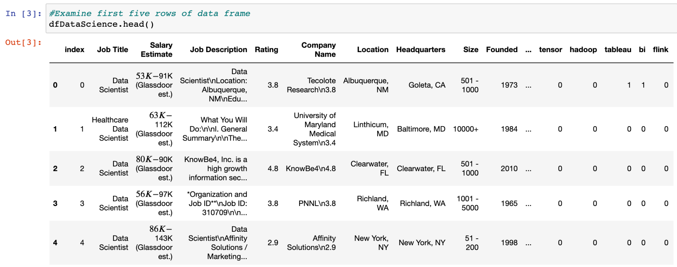
Data source: Glassdoor
The Dataset is scraped from Glassdoor. It contains salary data related to the position of data scientists” There are 42 columns and 742 rows.
After cleaning - remaining variables:
Job title,
company name,
Rating,
Location, state,
industry, sector,
lower salary, upper salary, average salary,
python, spark, aws, excel, sql, sas, keras, pytorch, scikit, tensor, hadoop, tableau, BI, Flink, Mongo, Google_Analyttics,
degree

Slide 3
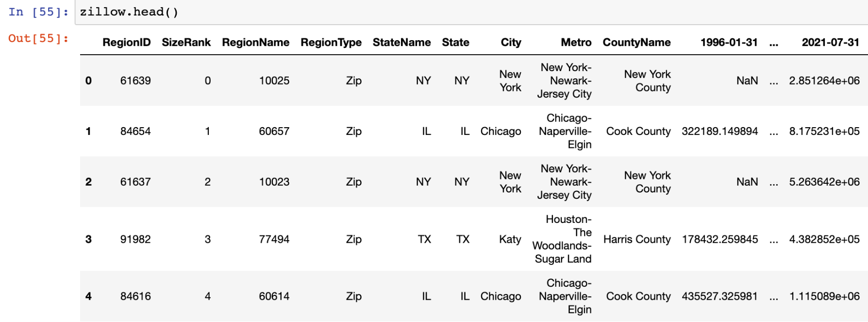
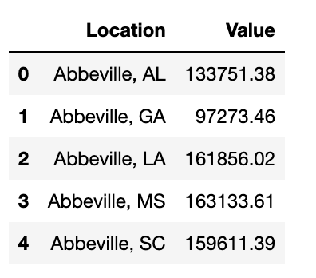
Data source: Zillow
The dataset is from Zillow.com. There are 29,770 rows and 325 columns. Each month from 1996 to 2021 is a column. We transformed the data to pertain only to 2021. The cleaned dataset contains an annual median housing value for each city, state.

Slide 4
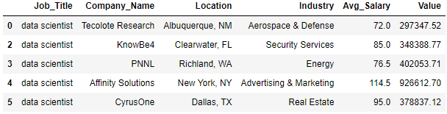
Merged Dataset
Merged Zillow and Glassdoor datasets based on Location to show estimated home cost for each job listing
23 rows lost in the merge, resulting in 434 rows

Slide 5
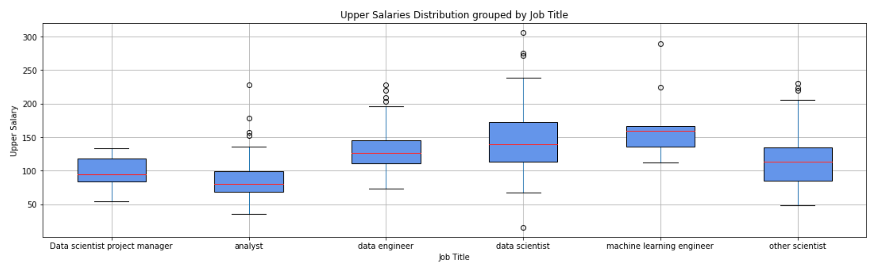
Glassdoor: Data Exploration Highlights
Question: What is the distribution of salaries by job title?
The boxplot shows the upper salaries by job title:

Slide 6
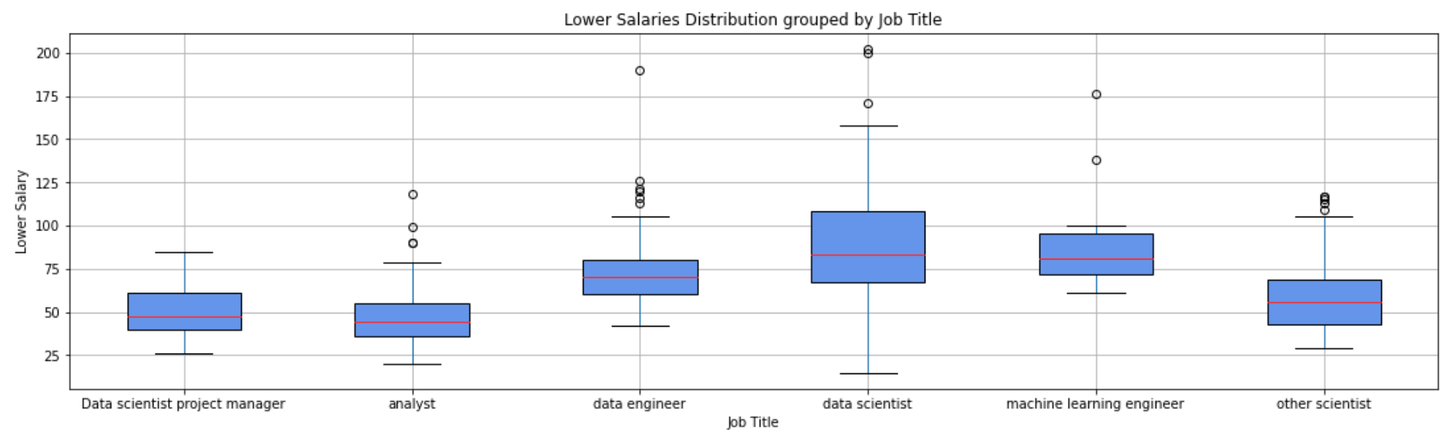
Glassdoor: Data Exploration Highlights
The boxplot shows the lower salaries by job title:

Slide 7
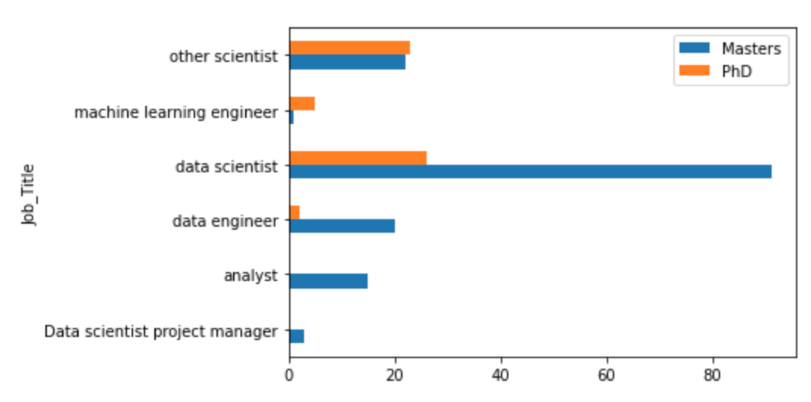
Glassdoor: Data Exploration Highlights
Question: Do certain job titles require specific degrees?
The countplot shows which job titles have degree requirements:

Slide 8
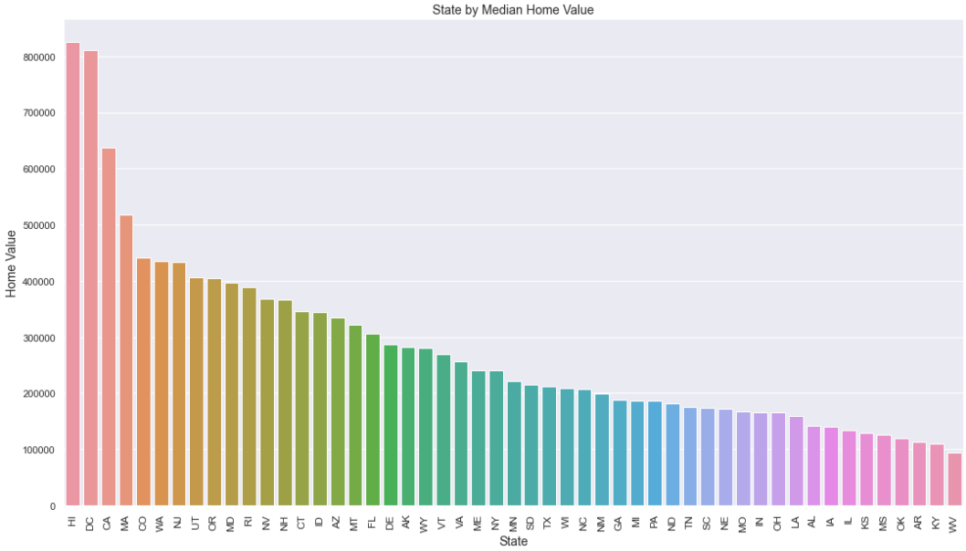
Zillow: Data Exploration Highlights
Question: How do the states compare in median home value?
Highest:
Hawaii
Washington D.C.
California
Massachusetts
Lowest:
West Virginia
Kentucky
Arkansas
Oklahoma

Slide 9
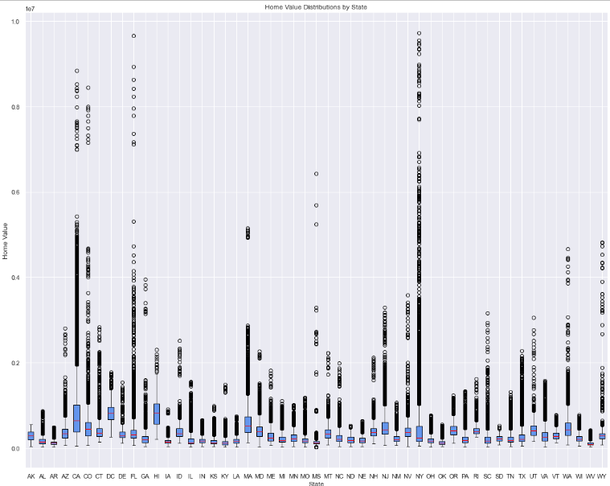
Zillow: Data Exploration Highlights
Question: What is the distribution of home values by state?
Many outliers (expensive houses)
Highest: Nearly $10 million
Highest variance: New York, Florida, California, Colorado, Mississippi
Lowest variance: Alaska, Arkansas, West Virginia, North Dakota, South Dakota

Slide 10
Program Questions
Can we create a custom filter based on user input similar to the filter effect on the Glassdoor website?
Based on job salary and user input on mortgage information, can we identify jobs in affordable housing areas?

Slide 11
Program 1: provides search research based on user input
User input: job title, lowest acceptable job rating out of 5, highest acceptable job rating out of 5, desired City, State , lower bound of desired salary and upper bound of desired salary
Finds all rows that full the users requirements.
Outputs:
If there are no matches, the program outputs “Sorry we could not find any results! Try modifying your search”
If one match is found, the program outputs the name of the company
If more than one match is found, the program outputs the names of the companies

Slide 12
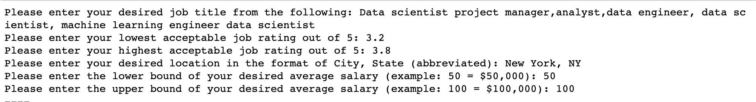
Program 1: provides search research based on user input
User Input:
Output:

Slide 13
Program 2: Identifies affordable housing areas based on user input and job salary
User Input: Desired job title, maximum PTI, down payment, fixed mortgage (15 yr or 30 yr), expected interest rate
Calculate payment to income (PTI)
Calculate gross monthly income on based on average salary
Calculate monthly mortgage payment based on user input
Calculate PTI: mortgage payment / gross monthly income
Filter dataset based on inputted job title and desired max PTI
Output results to .csv

Slide 14
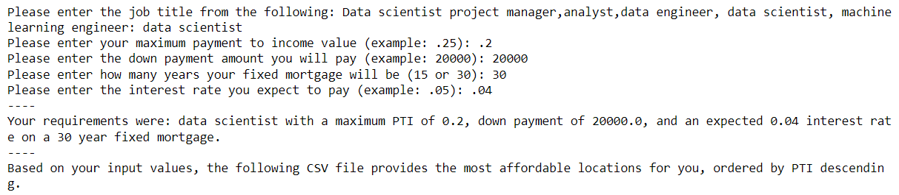
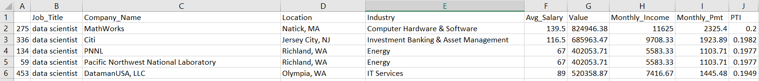
Program 2: Identifies affordable housing areas based on user input and job salary
User Input:
.csv Output:

Slide 15
Next Steps / Conclusion:
Next Steps:
Adjust programs to allow for more dynamic filtering (Allow user to enter multiple locations, add user input for multiple skills, etc.)
Scraping information from other websites could help users find concise answers in a multitude of ways.
Conclusion:
Best paid data science-related titles: Data scientist, machine learning engineer, data engineer
Likely to require advanced degrees
Most expensive areas: Hawaii, Washington D.C., California, Massachusetts,
User input programs very valuable for job-search and housing market tools
The ability to streamline the process based on user inputs shows the power of these coding techniques.

Slide 16
End

